Slide 1
Economic Indicators of Domestic Migration in the U.S.
Abdul Kamara, Mitchell Capell, Zachary Pitts, Smit Gandhi

Slide 2
What is the Main Economic Cause of Domestic Migration in the U.S.?
Four Main Factors that Affect Population Change in Any Region:
Birth Rates - Total number of live births per 1,000 in a population in a year or period.
Mortality Rates - The measure of the number of deaths in a particular population, scaled to the size of that population, per unit of time.
Domestic Migration - The movement of people within national boundaries with the intentions of settling, permanently or temporarily at a new location.
International Migration - The movement of people across national boundaries with the intentions of settling, permanently or temporarily at a new location.

Slide 3
What is the Main Economic Cause of Domestic Migration in the U.S.?
In our presentation we will be focusing on the economic factors that affect domestic migration in the United States.
Our groups desire to understand what factors Affect domestic migration stemmed from our acknowledgement of some current population trends in the U.S.:
People are moving away from states with high taxes, real estate prices and cost of living.
Take this article from Business Insider for example.

Slide 4


Factors of Migration
Notes:
Figure 2. Complex drivers of migration: macro-, meso- and micro-factors Source: Foresight: Migration and Global Environmental Change (2011) Final Project Report The Government Office for Science, London, modified
Unless provided in the caption above, the following copyright applies to the content of this slide: © International Society of Travel Medicine 2018. Published by Oxford University Press. All rights reserved. For Permissions, please e-mail: journals.permissions@oup.comThis article is published and distributed under the terms of the Oxford University Press, Standard Journals Publication Model (https://academic.oup.com/journals/pages/about_us/legal/notices)

Slide 5
Economic Factors
What factors will we analyze with what data ?
Taxes – State income tax levels per state based on median household income levels per state.
Income – State median household income levels from 2010 – 2018 using the US Census Bureau.
Rent – State median rental rates for a 2BR apartment for 2016 using a Zillow dataset via Kaggle.
The basis for our comparisons are derived from a state-to-state migration table for 2016-2017 from the US Census Bureau. We plan to prove the trends outlined in the Business Insider articles and further analyze economic factors that could affect those migration trends. Our goal is to ascertain which economic factor under our analysis has the strongest impact on domestic migration.

Slide 6
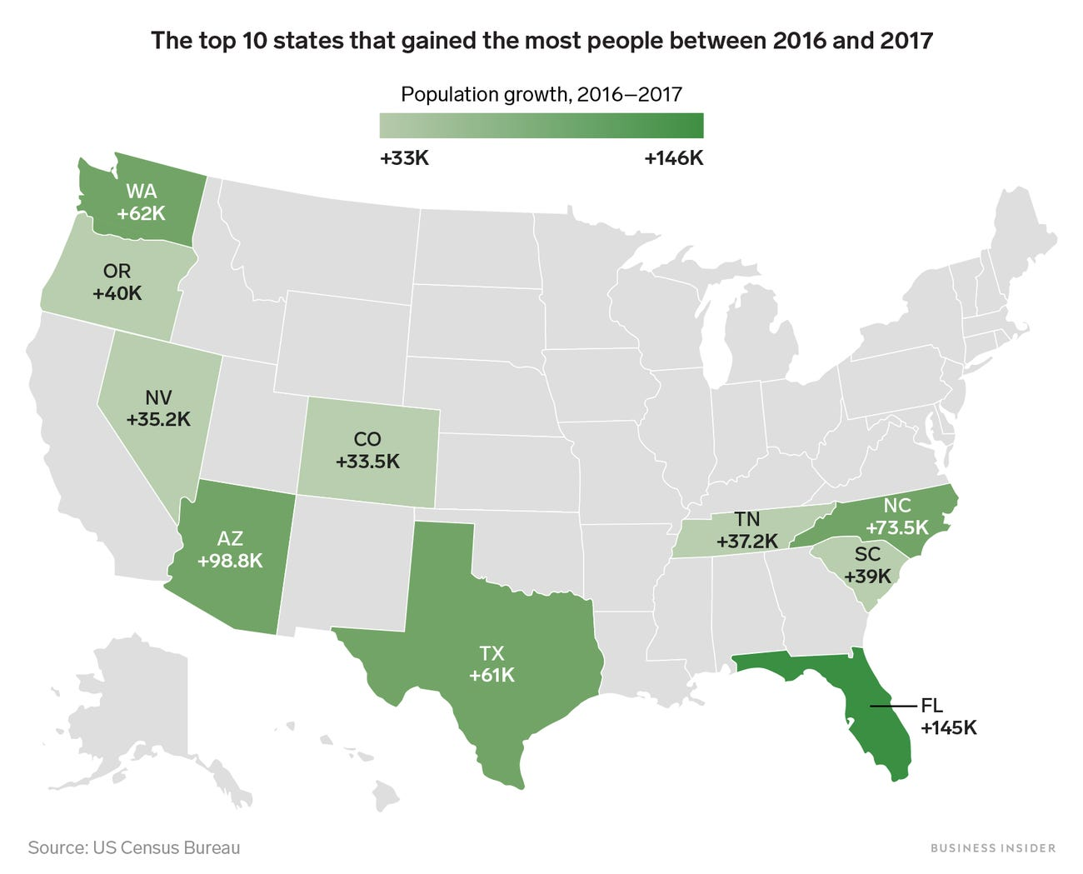
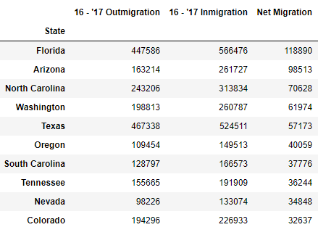
Population Trends – Top Ten States

Slide 7
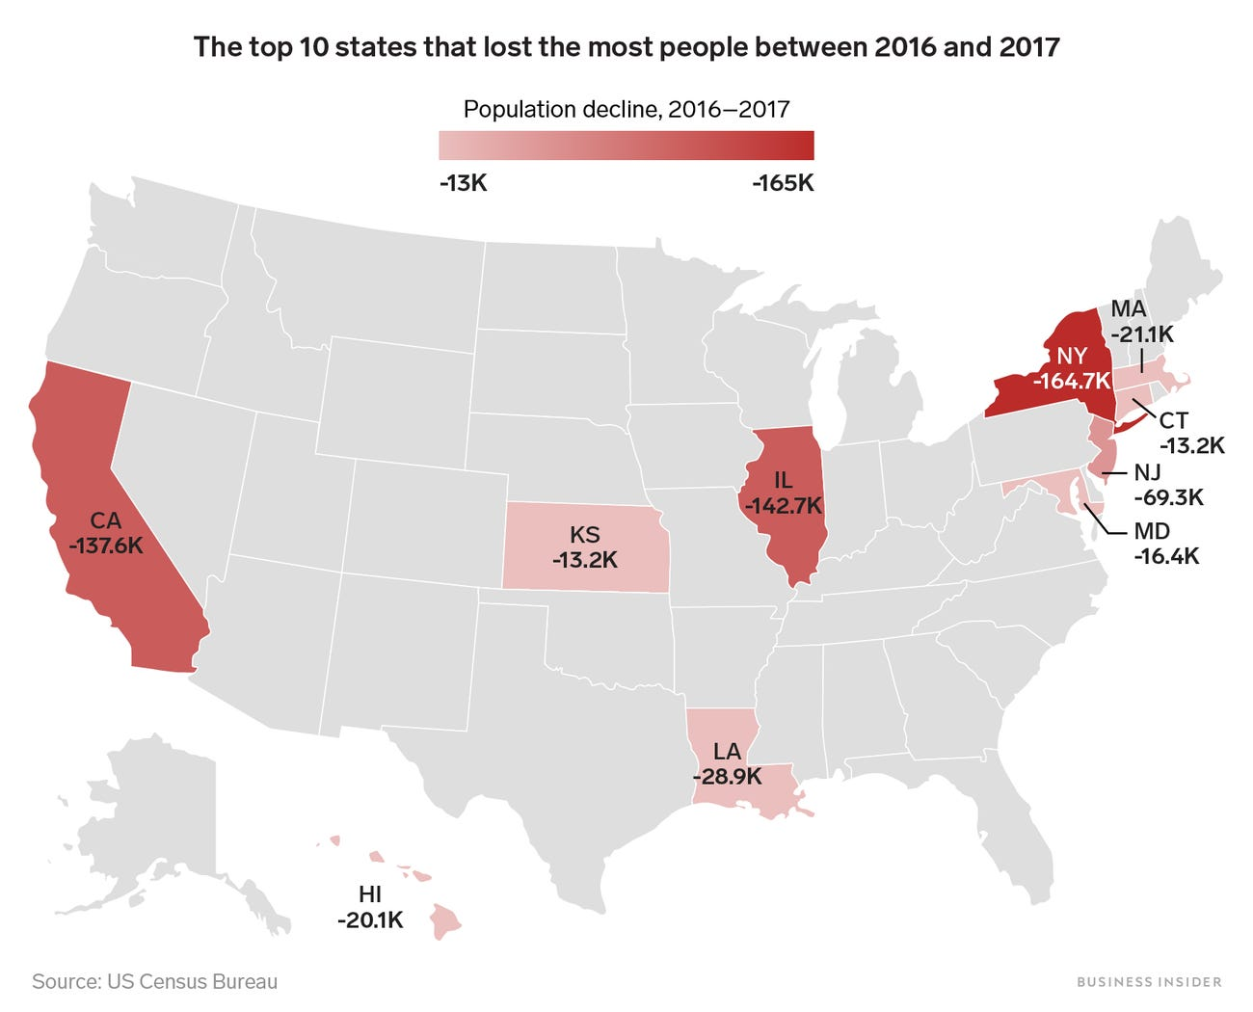
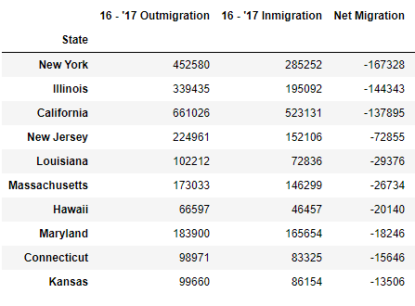
Population Trends – Bottom Ten States

Slide 8
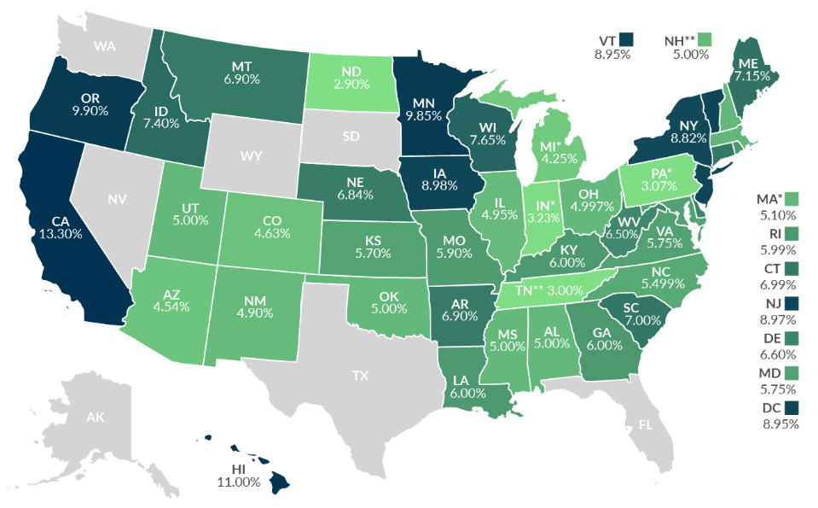
Taxes
“Our new Constitution is now established, and has an appearance that promises permanency; but in this world nothing can be said to be certain, except death and taxes.” –
Benjamin Franklin

Slide 9
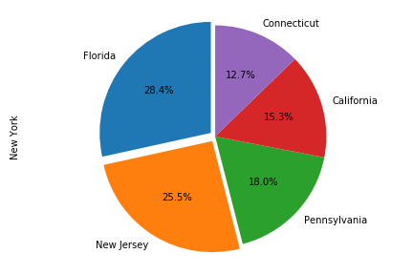
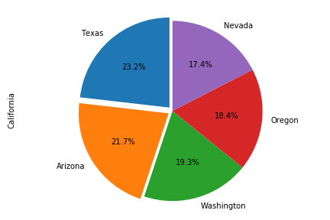
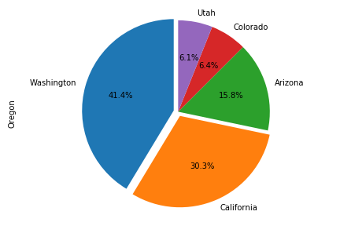
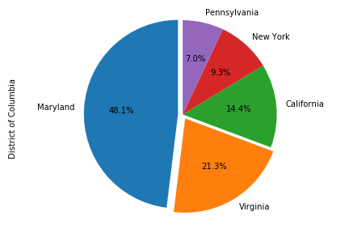
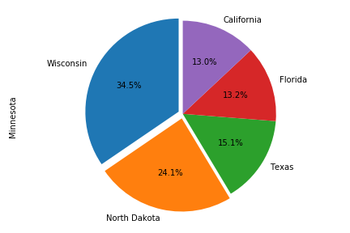
Where are People in High Tax States Moving to ?
New York
California
Oregon
District of Columbia
Minnesota

Slide 10
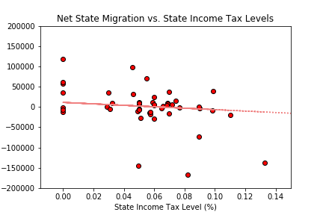
Does Low and No State Income Tax Affect Domestic Migration in the U.S.?
Net State Migration

Slide 11
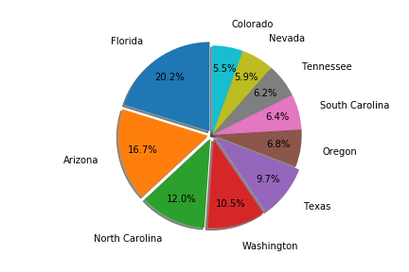
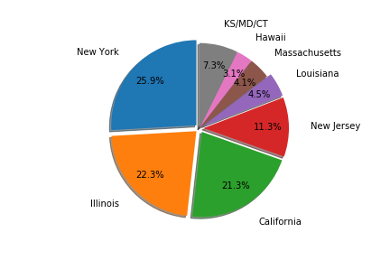
Does Low and No State Income Tax Affect Domestic Migration in the U.S.?
Top Ten States – Population Growth
Bottom Ten States – Population Decline

Slide 12
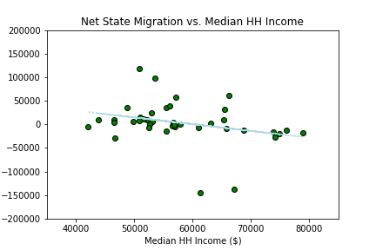
How do Median State Employment Earnings Affect Domestic Migration ?
Net State Migration

Slide 13
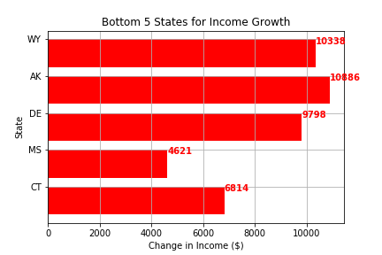
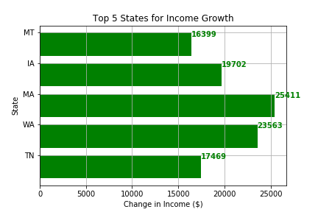
States With the Highest and Lowest Income Changes

Slide 14
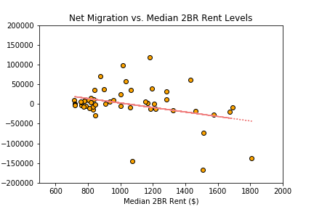
Does Rent Affect Domestic Migration in the U.S.?
Net State Migration

Slide 15
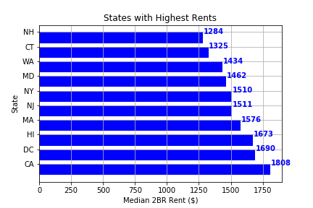

Slide 16
Conclusion
We found that the highest taxed states as well as states with the highest rents are experiencing population decline. States with lower taxes are experiencing population growth, however rents are still relatively high, but not as high as highly taxed states.
This correlation however does not prove causation. They are trends to analyze and help us understand state-to-state migration. There is a case to be made that lower cost (less taxes, lower rents) can outweigh higher income levels in migration decisions. States with high taxes and rents also tend to have the highest income levels.
It is interesting to note another economic factor affecting migration, but not included in our analysis, job opportunities and job growth. If supplied with more time in our analysis we would have further investigated job opportunities as an economic indicator of migration. We would also look into social factors that affect migration such as seeking higher education and family obligations.
Based on our pie charts describing where highly taxed residents were moving, social factors possibly play a larger role than economic factors when it comes to migration.

Slide 17
Data Cleanup, Exploration & Post-Mortem
We used Excel to cleanup our csv files received from the US Census Bureau and Kaggle. We then used Pandas to store the csv data into a data frame, merge data frames depending on the data comparison, and plotted those comparisons in matplotlib using pie charts, scatter plots and bar charts.
The toughest challenge was finding the right data. We figured out that in order to compare economic factors of migration we had to evaluate ‘inmigration’ and ‘outmigration’ of every state to determine the net domestic migration. This made it so we could narrow down our data to domestic migration and not overall population change, which also includes international migration, birth rates and death rates.
Having published research to validate the correctness of our findings helped us dig harder to find the right census data. Once we found the right data set, we had to take the source format and make the data work in our favor based on the data we were aiming to validate. This is when the data cleaning process began.
Margin of error in the census data was the major difficulty that arose in our research. This explains why our net migration numbers did not quite match those from the Business Insider Article. Discovering the US Census’ methodology for ‘+/-’ estimates in the MOE data was tough to apply to the net migration data we calculated. If given more time we would have further researched how to apply the MOE to our data findings for more accurate data.

Slide 18
Q & A

